Slide 1
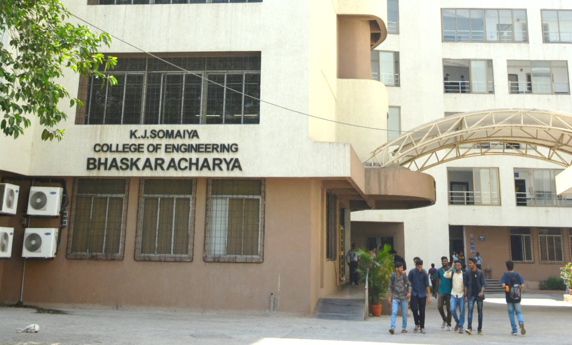
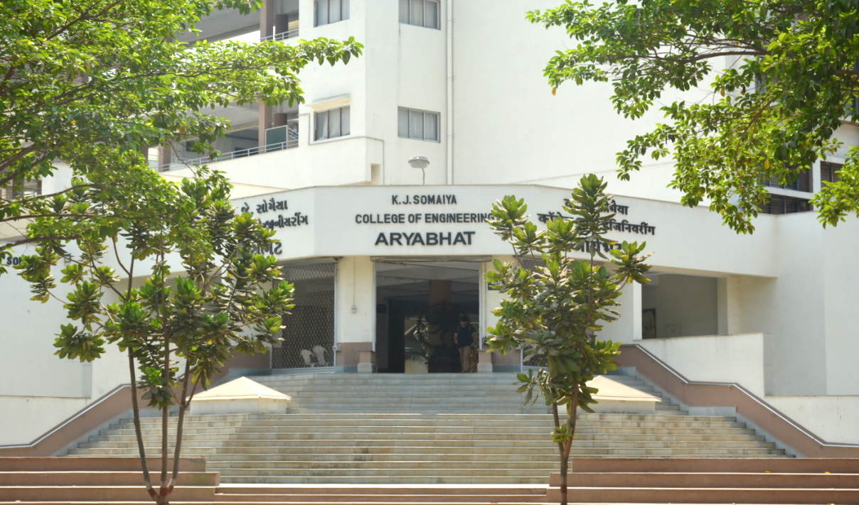
K J Somaiya College of Engineering, Mumbai-77
(Constituent college of Somaiya Vidyavihar University)
Title : CareShield – Face Mask Detector
Presented by: Rohit Deshpande (16010122041)
Shubh Jalui (16010122072)
Ninad Marathe (16010122106)
Notes:
`

Slide 2
INTRODUCTION AND PROBLEM STATEMENT
The Face Mask Detector is an AI-powered application that uses computer vision to automatically identify whether people are wearing face masks in real time. It combines a deep learning model with a user-friendly web interface, making it suitable for use in public spaces, workplaces, and other environments where mask compliance is important.
There is a critical need for an automated system to detect whether individuals are wearing face masks in real time. Manual monitoring is inefficient and error-prone, especially in crowded settings. An AI-based solution can provide accurate, instant feedback on mask compliance. This helps enforce public health measures and reduces the risk of disease transmission.

Slide 3
MOTIVATION
TThe COVID-19 pandemic underscored the vital role of face masks in minimizing the transmission of infectious diseases. However, ensuring widespread compliance with mask mandates through manual monitoring is both labor-intensive and prone to human error, especially in high-traffic or crowded environments. Such inefficiencies can lead to lapses in safety and increased risk of outbreaks. By leveraging automated face mask detection systems powered by artificial intelligence, organizations can achieve consistent, real-time monitoring, reduce the reliance on human resources, and create safer public spaces. This technological approach not only streamlines enforcement but also fosters greater public confidence in health and safety measures.

Slide 4
SCOPE
Face Detection and Mask Classification: The system will accurately detect human faces in images or video streams and classify each as "mask" or "no mask" using deep learning models.
Real-Time Monitoring: It will provide immediate feedback on mask compliance, suitable for deployment in public spaces, workplaces, and other high-traffic areas.
User Interface: An intuitive interface will display detection results clearly, making it easy for users to monitor compliance.
Performance Optimization: The project will focus on efficient processing to ensure smooth operation, even on systems with limited resources.
Extensibility: The solution can be enhanced with features like alert notifications or integration with existing surveillance systems to meet diverse application needs.

Slide 5
Some Limitations:
Detection accuracy can decrease in poor lighting or when faces are partially covered.
Models may not perform well on faces or masks not represented in the training data.
Real-time detection may be slow on devices with limited processing power.
Identifying multiple faces in crowded scenes can be challenging.
The system may not reliably detect improper mask usage, such as masks worn below the nose.

Slide 6
OBJECTIVES
Develop a Real-Time Detection System: Create a system that can accurately detect the presence or absence of face masks on individuals in live video streams or images using deep learning techniques.
Achieve High Accuracy and Efficiency: Ensure the detection model delivers high accuracy (targeting above 95%) and processes data efficiently to support deployment in large-scale, high-traffic environments.
On-Screen Compliance Visualization: Display the percentage of people wearing masks directly on the screen, using green to indicate satisfactory compliance and red to highlight low compliance levels.
Integrate a Healthcare Chatbot: Incorporate a chatbot within the system to provide users with healthcare-related information and assistance, particularly regarding COVID-19 and mask usage.

Slide 7
METHODOLOGY AND IMPLEMENTATION
The following methodology was adopted to implement the Fake News Detection project:
Data Collection: Gather a diverse dataset of images with and without face masks.
Preprocessing: Resize images, normalize pixel values, and augment data for robustness.
Feature Extraction: Use deep learning models (e.g., MobileNetV2) to automatically extract features.
Model Training: Train and validate a classifier (e.g., CNN) to distinguish between masked and unmasked faces.
Evaluation: Measure model accuracy, precision, recall, and F1-score.
Deployment: Implement real-time detection with OpenCV and deploy the system for live video monitoring.

Slide 8
LITERATURE SURVEY
Most face mask detection research uses deep learning, especially CNN-based models like MobileNetV2, ResNet, and YOLO, achieving high accuracy in both images and real-time video.
While some lightweight models enable real-time detection, challenges remain with varying mask types, face angles, and lighting conditions.
Traditional machine learning methods are faster but less accurate compared to deep learning approaches.
Few studies incorporate metadata, social context, or user behavior, and advanced models like BERT or multimodal techniques are rarely explored.
There is a need for more context-aware and robust detection systems that can adapt to diverse real-world scenarios.

Slide 9
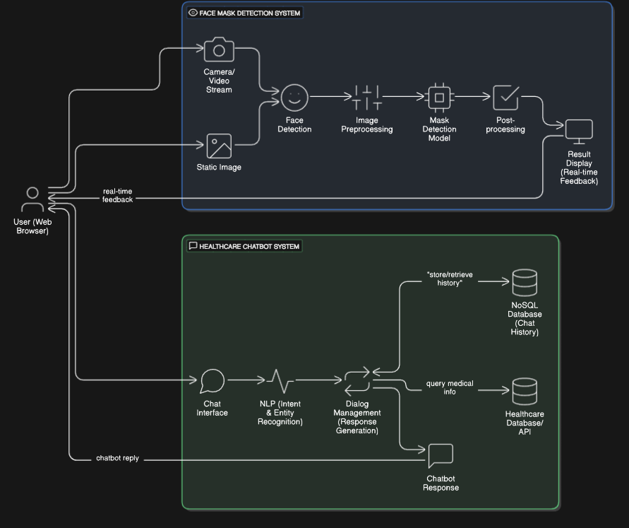
ARCHITECTURAL DIAGRAM

Slide 10
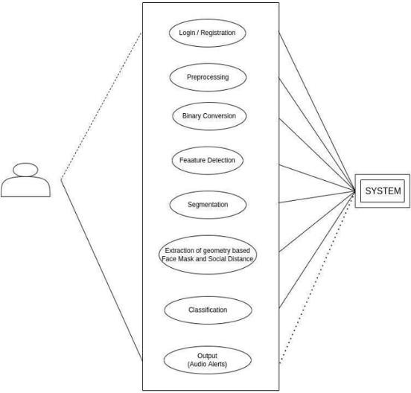
USECASE DIAGRAM

Slide 11
PLANNING, CHALLENGES AND EXPECTED OUTCOMES
Structured Project Plan:
Defined roles: Data Collection, Model Training, Interface Development, Testing.
Timeline: Research → Data Preparation → Model Training & Integration → Deployment.
Challenges:
Data Diversity: Handling different mask types and face orientations.
Real-Time Performance: Ensuring fast, accurate detection on various devices.
Expected Outcomes:
Accurate real-time face mask detection with on-screen compliance visualization.
Future enhancements: Detecting improper mask usage and chatbot improvements.

Slide 12
CONCLUSION AND FUTURE ENHANCEMENTS
Face mask detection is vital for automated public health monitoring, reducing manual checks and ensuring safety in crowded spaces through AI-driven real-time compliance.It establishes a foundation for AI-based health safety solutions, supporting rapid compliance checks and adapting to future public health needs.
Future Enhancements:
Expand to detect improper mask usage, integrate with social distancing monitoring, enable deployment across multiple cameras or systems, and add noise/beep alerts for non-compliance.

Slide 13
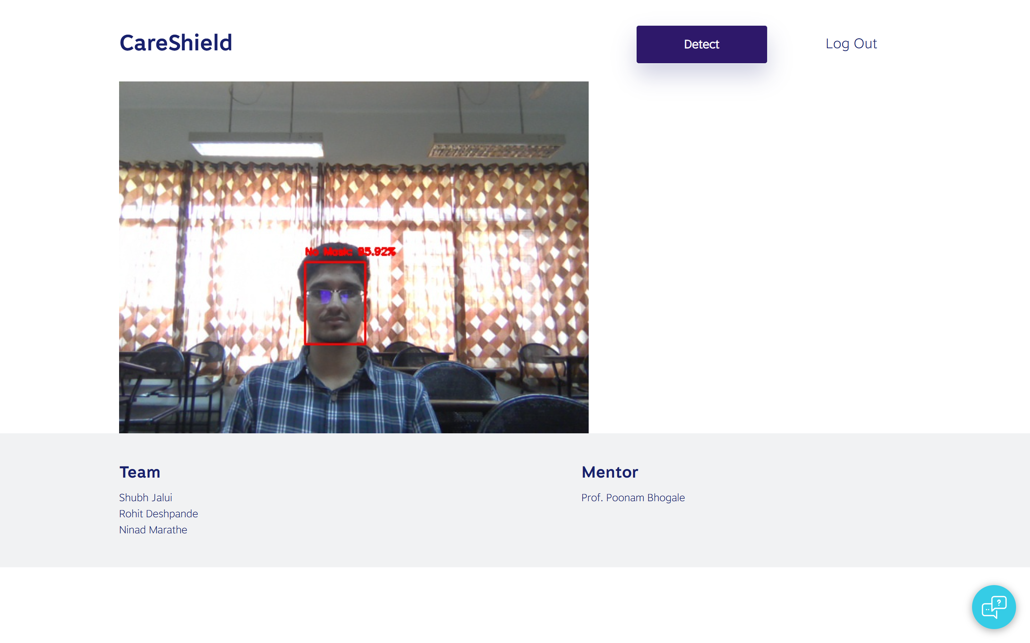
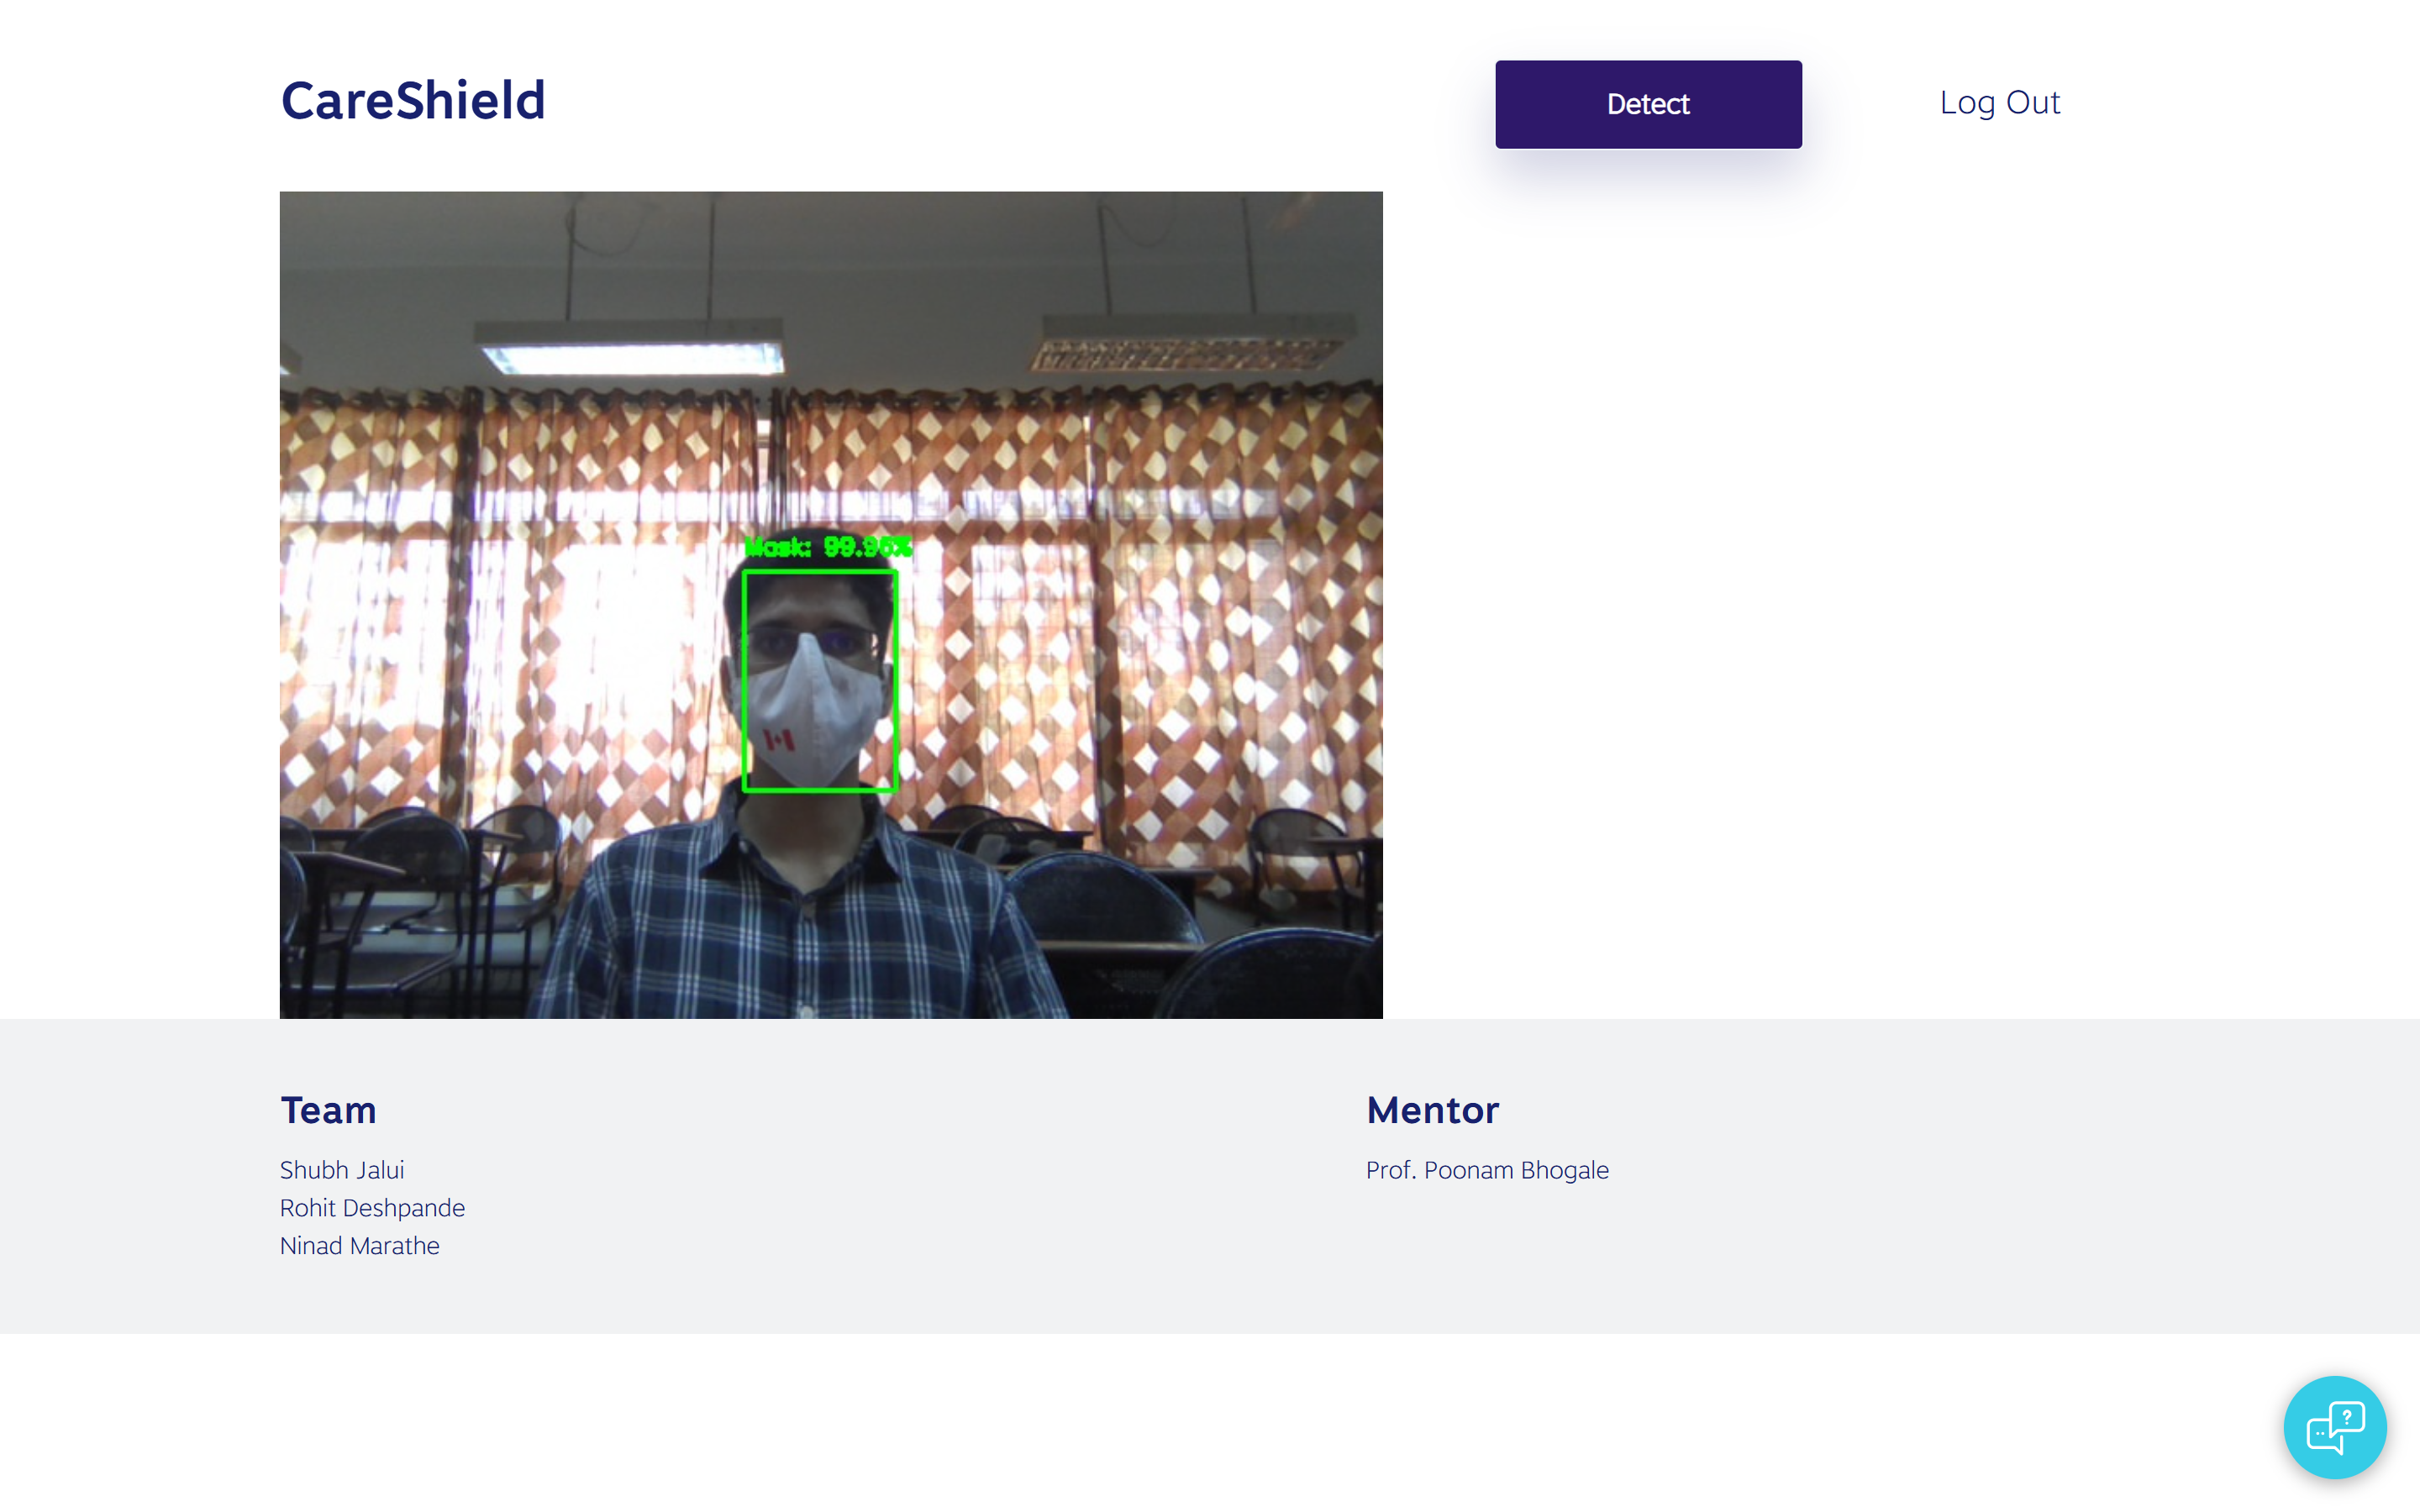
SCREENSHOTS
Without Mask
With Mask

Slide 14
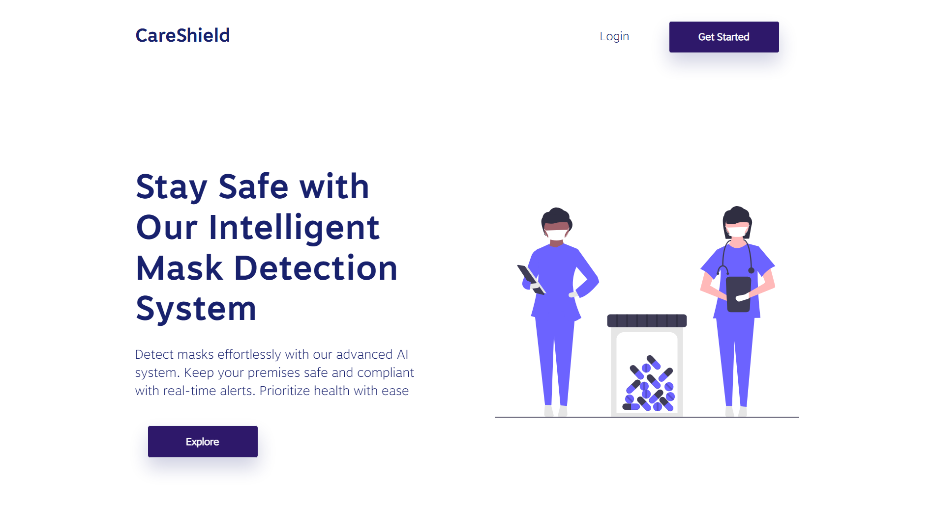
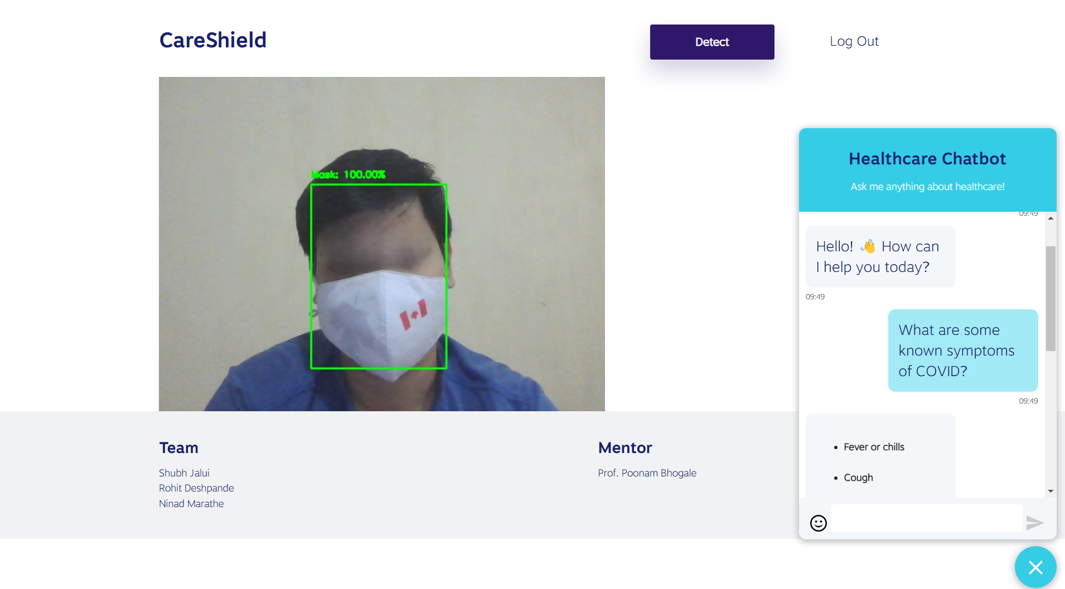
SCREENSHOTS
Demo link (video): https://drive.google.com/file/d/1W_Fq46yCJ4Dcf87ixlQKASRhSQJ3TIaB/view?usp=sharing

